Slide 1
STOR 455 Class 11 (Logistic regression)
Read: 9.1-9.4
Exercises: 9.21, 33, 35, 36, 37

Slide 2
Logistic Regression
In all of our regression models (so far) the response variable, Y, has been quantitative.
What if we want to model a categorical response?

Slide 3
Categorical Response Variables
Examples:
Whether or not a person smokes
Binary
Response
Success of a medical treatment
Opinion poll responses
Ordinal Response

Slide 4
Categorical Response Variables
Examples:
Political preference
Nominal response
Three “flavors” of logistic regression:
binary
ordinal
nominal

Slide 5
Binary Logistic Regression
Response variable (Y) is categorical with just two categories (yes/no or success/failure or 0/1 …).
One approach: Code the response Y as a (0,1) dummy (indicator) variable.
Assume we have a single quantitative predictor X.

Slide 6
Titanic Survival
Y = Survived (0 = no; 1 = yes) X = Fare (ticket cost in dollars)
library(titanic)
data("titanic_train")
Titanic_mod = lm(Survived ~ Fare, data=titanic_train)
summary(Titanic_mod)
Coefficients:
Estimate Std. Error t value Pr(>|t|)
(Intercept) 0.3026994 0.0187849 16.114 < 2e-16 ***
Fare 0.0025195 0.0003174 7.939 6.12e-15 ***
---
Signif. codes: 0 ‘***’ 0.001 ‘**’ 0.01 ‘*’ 0.05 ‘.’ 0.1 ‘ ’ 1
Residual standard error: 0.4705 on 889 degrees of freedom
Multiple R-squared: 0.06621, Adjusted R-squared: 0.06516
F-statistic: 63.03 on 1 and 889 DF, p-value: 6.12e-15

Slide 7
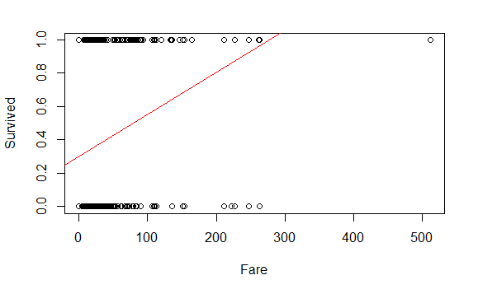
plot(Survived ~ Fare, data=titanic_train)
abline(Titanic_mod, col="red")

Slide 8
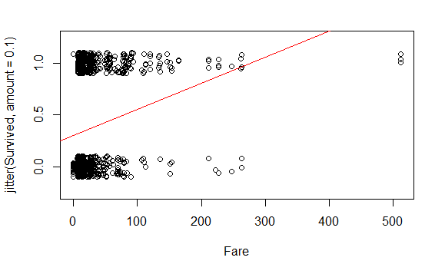
plot(
jitter(Survived, amount=0.1) ~ Fare,
ylim = c(-0.25,1.25),
data=titanic_train
)
abline(Titanic_mod, col="red")

Slide 9
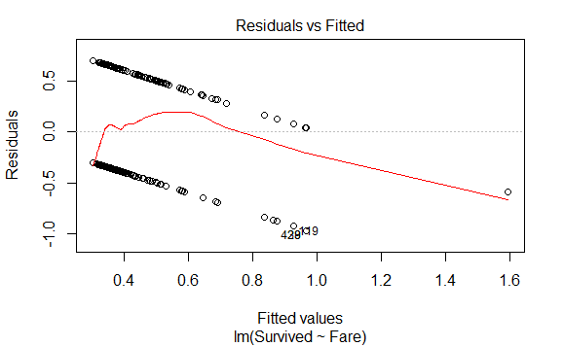
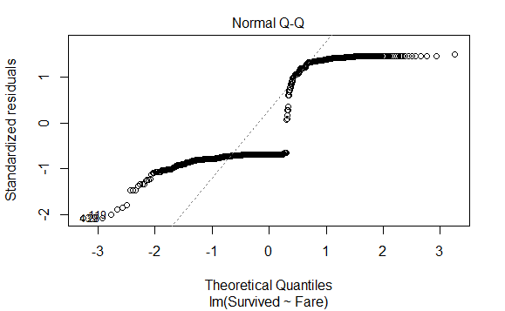
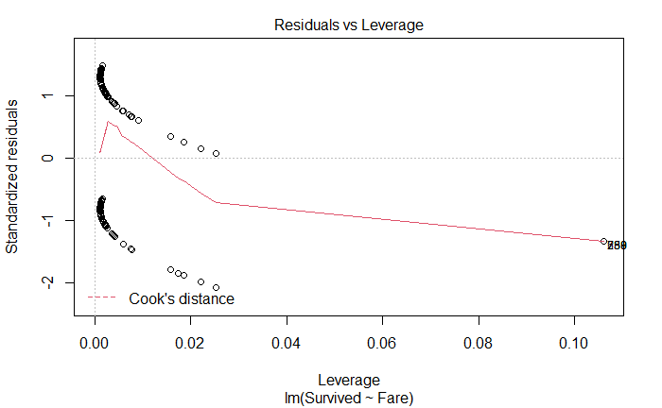
plot(Titanic_mod, c(1, 2, 5))

Slide 10
Binary Logistic Regression Model
Y = Binary response
X = Quantitative predictor
π = proportion of 1’s (yes, success,…) at any x
curve(exp(B0+B1*x)/(1+exp(B0+B1*x)),add=TRUE, col="red")
Probability form

Slide 11
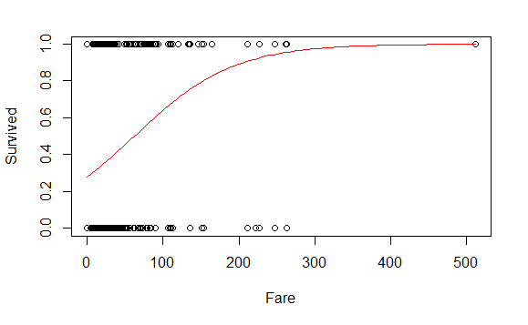
Titanic_logitmod = glm(Survived ~ Fare, family = binomial, data=titanic_train)
plot(Survived ~ Fare, data=titanic_train)
B0 = summary(Titanic_logitmod )$coef[1]
B1 = summary(Titanic_logitmod )$coef[2]
curve(exp(B0+B1*x)/(1+exp(B0+B1*x)),add=TRUE, col="red")

Slide 12
Predicting Proportion of “Success”
In regression the model predicts the mean Y for any combination of predictors.
What’s the “mean” of a 0/1 indicator variable?
Goal for this model: Predict the “true” proportion of success, π, at any value of the predictor.

Slide 13
set.seed(05312022)
passenger = titanic_train[sample(nrow(titanic_train),1),]
passenger$Fare
[1] 7.3125
predict(logitmodT, passenger, type="response")
155
0.3036022

Slide 14
logitmodT=glm(Survived~Fare,family=binomial,data=titanic_train)
plot(Survived~Fare, data=titanic_train)
B0 = summary(logitmodT)$coef[1]
B1 = summary(logitmodT)$coef[2]
curve(exp(B0+B1*x)/(1+exp(B0+B1*x)),add=TRUE, col="red")

Slide 15
Binary Logistic Regression Model
Y = Binary response
X = Quantitative predictor
π = proportion of 1’s (yes, success,…) at any x
Probability form
Logit form
Linear Model

Slide 16
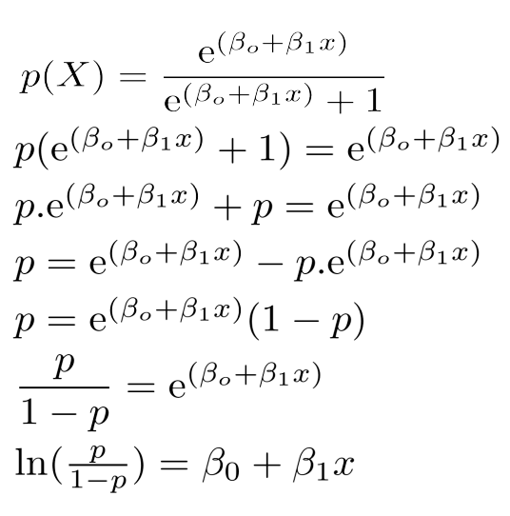
Binary Logistic Regression Model
Probability form
Logit form

Slide 17
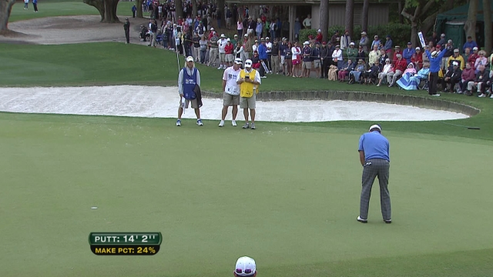
Golf Putts

Slide 18
Example: Golf Putts
Length | 3 | 4 | 5 | 6 | 7
Made | 84 | 88 | 61 | 61 | 44
Missed | 17 | 31 | 47 | 64 | 90
Total | 101 | 119 | 108 | 125 | 134
Build a model to predict the proportion of putts made (success) based on length (in feet).
Data are in Putts1 of Stat2Data.

Slide 19
Logistic Regression for Putting
modPutt=glm(Made~Length,family=binomial,data=Putts1)
summary(modPutt)
Coefficients:
Estimate Std. Error z value Pr(>|z|)
(Intercept) 3.25684 0.36893 8.828 <2e-16 ***
Length -0.56614 0.06747 -8.391 <2e-16 ***
---
Null deviance: 800.21 on 586 degrees of freedom
Residual deviance: 719.89 on 585 degrees of freedom
AIC: 723.89

Slide 20
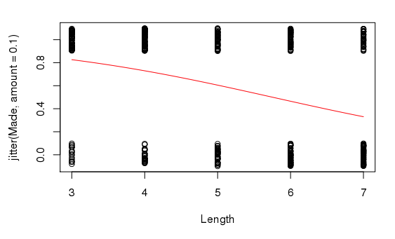
B0 = summary(modPutt)$coef[1]
B1 = summary(modPutt)$coef[2]
plot(jitter(Made, amount = 0.1) ~ Length, data = Putts1)
curve(exp(B0+B1*x)/(1+exp(B0+B1*x)), add=TRUE, col="red")

Slide 21
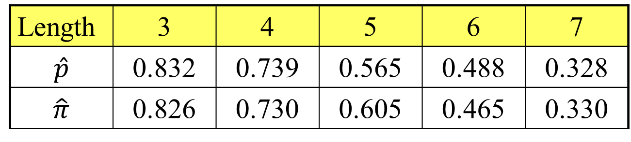
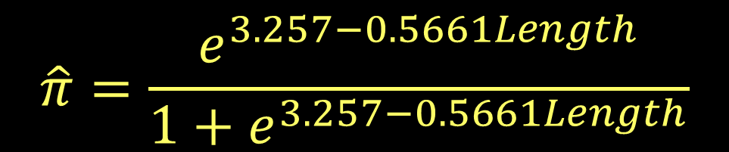

Golf Putts Probabilities
$$\hat{p}=\frac{\# made}{\# trials}$$
Length | 3 | 4 | 5 | 6 | 7
$$\hat{p}$$ | 0.832 | 0.739 | 0.565 | 0.488 | 0.328
$$\hat{π}$$ | 0.826 | 0.730 | 0.605 | 0.465 | 0.330
$$\hat{π}=\frac{e^{3.257−0.5661Length}}{1+e^{3.257−0.5661Length}}$$

Slide 22

Golf Putts Probabilities
Length | 3 | 4 | 5 | 6 | 7
$$\hat{p}$$ | 0.832 | 0.739 | 0.565 | 0.488 | 0.328
$$\hat{π}$$ | 0.826 | 0.730 | 0.605 | 0.465 | 0.330
Putts.table = table(Putts1$Made, Putts1$Length)
p.hat = as.vector(Putts.table[2,]/colSums(Putts.table))
p.hat
[1] 0.8316832 0.7394958 0.5648148 0.4880000 0.3283582

Slide 23

Golf Putts Probabilities
Length | 3 | 4 | 5 | 6 | 7
$$\hat{p}$$ | 0.832 | 0.739 | 0.565 | 0.488 | 0.328
$$\hat{π}$$ | 0.826 | 0.730 | 0.605 | 0.465 | 0.330
logit = function(B0, B1, x)
{
exp(B0+B1*x)/(1+exp(B0+B1*x))
}
pi.hat = logit(B0, B1, c(3:7))
pi.hat
[1] 0.8261256 0.7295364 0.6049492 0.4650541 0.3304493

Slide 24
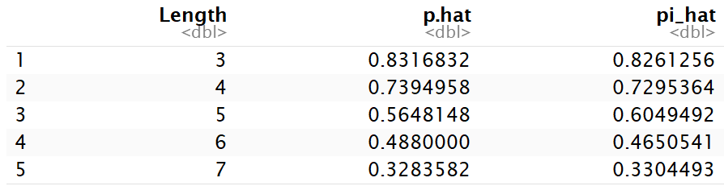

Golf Putts Probabilities
Length | 3 | 4 | 5 | 6 | 7
$$\hat{p}$$ | 0.832 | 0.739 | 0.565 | 0.488 | 0.328
$$\hat{π}$$ | 0.826 | 0.730 | 0.605 | 0.465 | 0.330
Putts = data.frame(
"Length" = c(3:7),
"p.hat" = p.hat,
"pi.hat" = pi.hat)

Slide 25
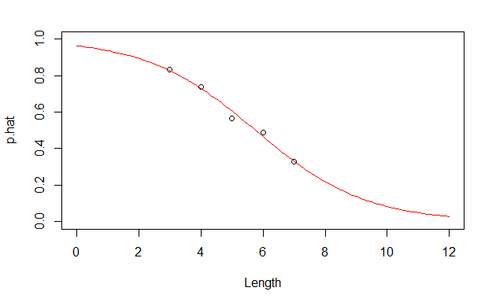
Probability Form of Putting Model
plot(p.hat~Length,ylim=c(0,1), xlim=c(0,12), data=Putts)
curve(logit(B0, B1, x), add=TRUE, col="red")

Slide 26

Odds
The odds against a certain horse winning a race are 4 to 1. What does that mean?
P(Win)=1/5
4 losses for every 1 win
P(Loss)=4/5
$$Odds= \frac{P(Win)}{P(Loss)}=\frac{1/5}{4/5}=\frac{1}{4}$$

Slide 27

Odds
If π = proportion of “yes” (success, 1, ….)
the odds of yes are(is)
$$\frac{P(yes)}{P(no)}=\frac{π}{1−π}$$
With a little bit of algebra…

Slide 28
Odds and Logistic Regression
Logit form:
⇒
The logistic model assumes a linear relationship between the predictor and log(odds).

Slide 29
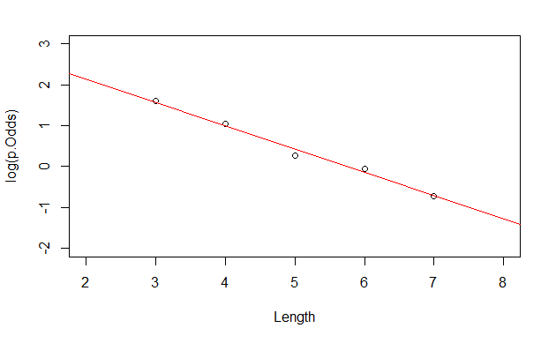

Logit Form of Putting Model
$$\log\left(\hat{odds}\right)=3.257−0.566∙Length$$
Linear part of logistic fit

Slide 30




Back to Putting Data
Since we have lots of putts, we can estimate $\hat{p}$ (proportion of putts made) at each length
$$\hat{p}=\frac{\# made}{\# trials}$$
and the odds
$$\hat{odds}=\frac{\# made}{\# missed}=\frac{\hat{p}}{1−\hat{p}}$$
and find $log⁡(\hat{odds})$ at each length.

Slide 31
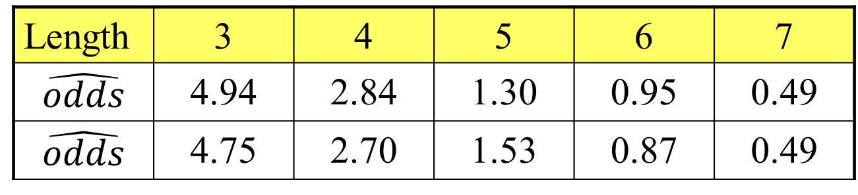


Golf Putts Odds
$\hat{odds}=\frac{\# made}{\# missed}=\frac{\hat{p}}{1−\hat{p}}$ (from sample)
Length | 3 | 4 | 5 | 6 | 7
$$\hat{odds}$$ | 4.94 | 2.84 | 1.30 | 0.95 | 0.49
$$\hat{odds}$$ | 4.75 | 2.70 | 1.53 | 0.87 | 0.49
$\hat{odds}=\frac{\hat{π}}{1−\hat{π}}$ (from logistic regression)
Putts$p.Odds = Putts$p.hat/(1-Putts$p.hat)
Putts$pi.Odds = Putts$pi.hat/(1-Putts$pi.hat)

Slide 32

Plot for Putts Data
Plot $log⁡(\hat{odds})$ versus Length (3, 4, 5, 6, 7)
Add a line with intercept and slope from the logistic model.
plot(log(p.Odds)~Length, data=Putts, xlim=c(2,8), ylim=c(-2,3))
abline(B0, B1, col="red")

Slide 33

Logit Form of Putting Model
$$\log\left(\hat{odds}\right)=3.257−0.566∙Length$$
Linear part of logistic fit

Slide 34
Odds Ratio
A common way to compare two groups is to look at the ratio of their odds

Slide 35

Putting Data
Odds using data from 4 feet = 2.84
Odds using data from 3 feet = 4.94
➔ Odds ratio (4 ft to 3 ft) = $\frac{2.84}{4.94}=0.57$
The odds of making a putt from 4 feet are 57% of the odds of making from 3 feet.

Slide 36
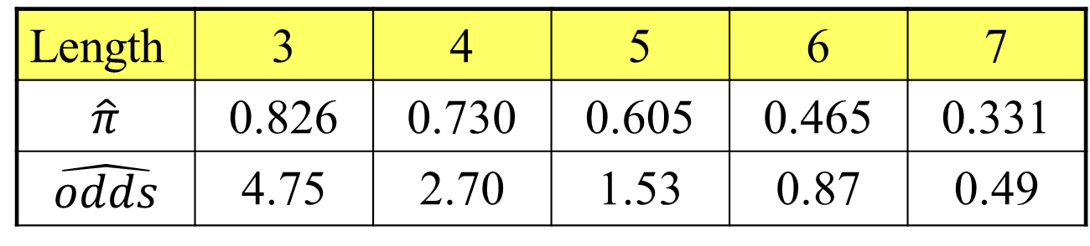

Odds Ratios for Putts
From fitted logistic:
Length | 3 | 4 | 5 | 6 | 7
$$\hat{π}$$ | 0.826 | 0.730 | 0.605 | 0.465 | 0.331
$$\hat{odds}$$ | 4.75 | 2.70 | 1.53 | 0.87 | 0.49
$$e^{{\hat{β}}_{1}}=e^{−0.566}=0.57$$
 | 4 to 3 feet | 5 to 4 feet | 6 to 5 feet | 7 to 6 feet
Odds Ratio | 0.57 | 0.57 | 0.57 | 0.57
In a logistic model, the odds ratio when changing the predictor by one is constant.

Slide 37
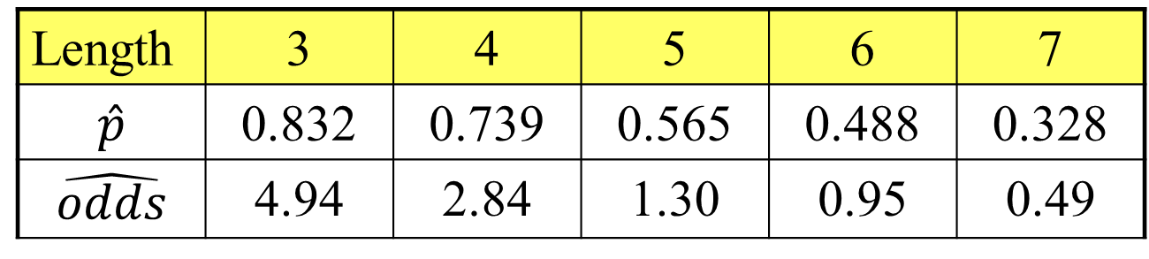
Odds Ratios for Putts
From samples at each distance:
Length | 3 | 4 | 5 | 6 | 7
$$\hat{p}$$ | 0.832 | 0.739 | 0.565 | 0.488 | 0.328
$$\hat{odds}$$ | 4.94 | 2.84 | 1.30 | 0.95 | 0.49
 | 4 to 3 feet | 5 to 4 feet | 6 to 5 feet | 7 to 6 feet
Odds Ratio | 0.57 | 0.46 | 0.73 | 0.51

Slide 38



Interpreting “Slope” using Odds Ratio
⇒
What happens when we increase x by one?
$$e^{β_{0}+β_{1}(x+1)}=e^{β_{0}+β_{1}x}∙e^{β_{1}}$$
When we increase x by one, the odds increase/decrease by a factor of $e^{β_{1}}$ (odds ratio).
For putts: The odds of making a putt decrease by a factor of 0.57 ($e^{−0.566}$) for every extra foot of length.

Slide 39





CI for Slope and Odds Ratio
Using the SE for the slope, find a CI for β₁ with
$${\hat{β}}_{1}±z^{∗}∙SE$$
To get CI for the odds ratio ($e^{β_{1}})$ exponentiate the CI for β₁
Estimate Std. Error z value Pr(>|z|)
(Intercept) 3.25684 0.36893 8.828 <2e-16 ***
Length -0.56614 0.06747 -8.391 <2e-16 ***
CI for slope:
$$−0.566±1.96(0.06747)$$
$$=(−0.698,−0.434)$$
CI for OR:
$${(e}^{−0.698},e^{−0.438})$$
$$=(0.497, 0.648)$$

Slide 40



CI for Slope and Odds Ratio
Using the SE for the slope, find a CI for β₁ with
$${\hat{β}}_{1}±z^{∗}∙SE$$
exp(confint.default(modPutt))
2.5 % 97.5 %
(Intercept) 12.6006177 53.5133410
Length 0.4973894 0.6479761
CI for OR:
$${(e}^{−0.698},e^{−0.438})$$
$$=(0.497, 0.648)$$

Slide 41
Recall: “Ordinary” Regression
Similar tests/measures for logistic regression?
lm(formula = Active ~ Rest)
Coefficients:
Estimate Std. Error t value Pr(>|t|)
(Intercept) 8.75340 5.60773 1.561 0.12
Rest 1.18387 0.08214 14.413 <2e-16 ***
Residual standard error: 14.39 on 310 degrees of freedom
Multiple R-squared: 0.4012, Adjusted R-squared: 0.3993
F-statistic: 207.7 on 1 and 310 DF, p-value: < 2.2e-16
Tests for individual coefficients
Compare models
Test for overall fit

Slide 42
Test for Individual Coefficients
Supplied by R
H_{o}: β_{i} = 0
H_{a}: β_{i} ≠ 0
P-value = 2P( Z > |t.s.| )
Interpret as with individual t-tests in ordinary regression
Estimate Std. Error z value Pr(>|z|)
(Intercept) 3.25684 0.36893 8.828 <2e-16 ***
Length -0.56614 0.06747 -8.391 <2e-16 ***

Slide 43

Estimating Parameters in Ordinary Regression
Coefficients are chosen to minimize the sum of the squared errors in the observed sample. (Least Squares Estimation)
$$SSE={Σ(y−\hat{y})}^{2}$$
Make this small

Slide 44
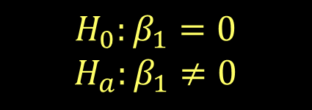


Test for Overall Fit
$$log\left(odds\right)=β_{0}$$
$$H_{0}:β_{1}=0$$
$$H_{a}:β_{1}≠0$$
Competing models
$$log\left(odds\right)=β_{0}+β_{1}X$$
How much “better” does the linear model do than one with a constant?
Is it “significantly” better?

Slide 45
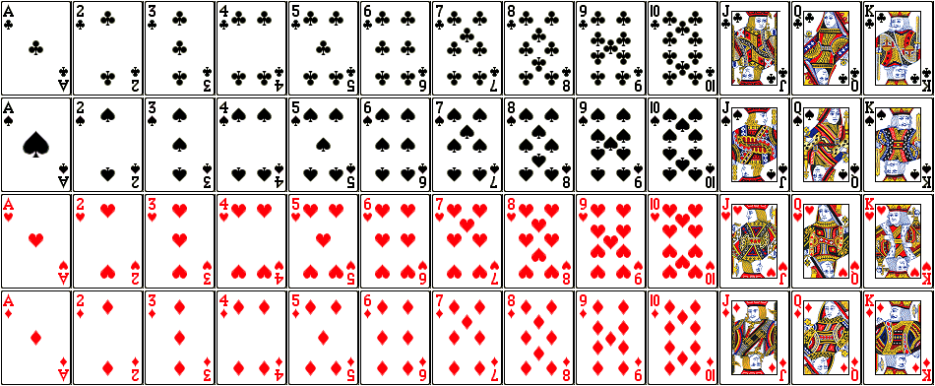
Maximizing the Likelihood of the Sample
Suppose that there are three decks of cards:
Standard 52 card deck
Euchre deck (9, 10, J, Q, K, A)
Deck with all red cards
If two cards were drawn from a deck (without replacement), a Jack of Hearts, then a King of Hearts, from which deck do you think that there were chosen?

Slide 46
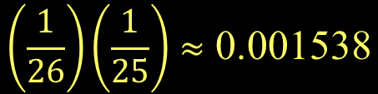
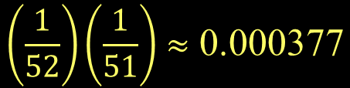
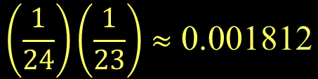
Maximizing the Likelihood of the Sample
Probability of this event for three decks:
Standard 52 card deck
Euchre deck (9, 10, J, Q, K, A)
Deck with all red cards
$$\left(\frac{1}{52}\right)\left(\frac{1}{51}\right)≈\text{0.000377}$$
$$\left(\frac{1}{24}\right)\left(\frac{1}{23}\right)≈\text{0.001812}$$
So, Euchre deck is most likely/has the highest likelihood!
$$\left(\frac{1}{26}\right)\left(\frac{1}{25}\right)≈\text{0.001538}$$

Slide 47
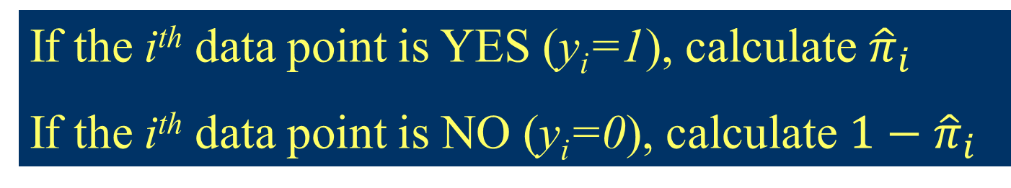
Estimating Parameters in Logistic Regression
Parameters are chosen to maximize the likelihood of the observed sample. (Maximum Likelihood Estimation)
If the i^{th} data point is YES (y_{i}=1), calculate ${\hat{π}}_{i}$
If the i^{th} data point is NO (y_{i}=0), calculate $1−{\hat{π}}_{i}$
Likelihood
Aim: Make this likelihood big

Slide 48
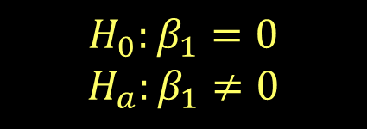
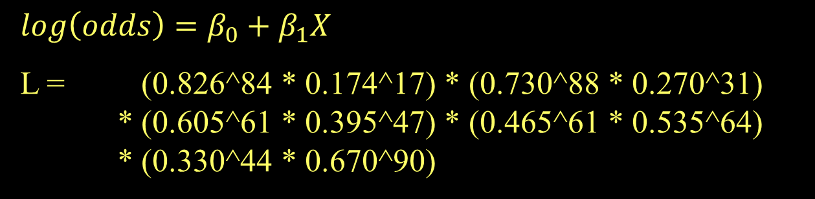
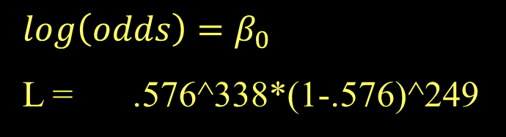
Test for Overall Fit
Length | 3 | 4 | 5 | 6 | 7
Made | 84 | 88 | 61 | 61 | 44
Missed | 17 | 31 | 47 | 64 | 90
 | 0.826 | 0.730 | 0.605 | 0.465 | 0.330
$$H_{0}:β_{1}=0$$
$$H_{a}:β_{1}≠0$$
$$log\left(odds\right)=β_{0}$$
L = .576^338*(1-.576)^249
$$log\left(odds\right)=β_{0}+β_{1}X$$
L = (0.826^84 * 0.174^17) * (0.730^88 * 0.270^31)
* (0.605^61 * 0.395^47) * (0.465^61 * 0.535^64)
* (0.330^44 * 0.670^90)

Slide 49


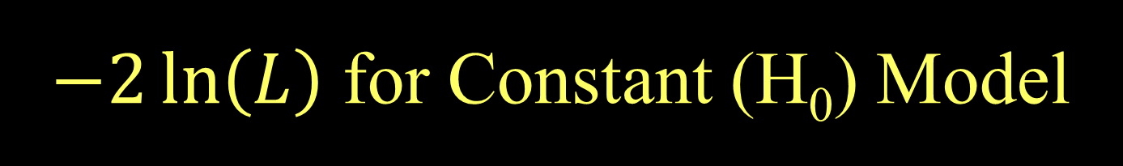
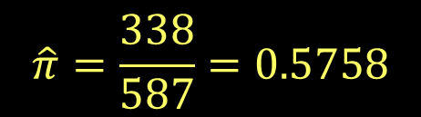
$−2\ln\left(L\right)$ for Constant (H₀) Model
For a constant model:
$$L_{0}={\hat{π}}^{\#yes}{(1−\hat{π})}^{n−\#yes}$$
$$\log\left(L_{0}\right)=\#yes∙\log\left(\hat{π}\right)+\#no∙log⁡(1−\hat{π})$$
Combining all putts: 338 made out of 587
$$\hat{π}=\frac{338}{587}=0.5758$$
$$L_{0}={0.5758}^{338}{0.4242}^{249}$$
$$\log\left(L_{0}\right)=338\log\left(0.576\right)+249\log\left(0.424\right)=−400.1$$
$$−2log\left(L_{0}\right)=800.2$$

Slide 50
Putts1: Made~Length
lmodPutt=glm(Made~Length,family=binomial,data=Putts1)
summary(lmodPutt)
Coefficients:
Estimate Std. Error z value Pr(>|z|)
(Intercept) 3.25684 0.36893 8.828 <2e-16
Length -0.56614 0.06747 -8.391 <2e-16
Null deviance: 800.21 on 586 degrees of freedom
Residual deviance: 719.89 on 585 degrees of freedom

Slide 51

Example: Golf Putts
Length | 3 | 4 | 5 | 6 | 7
Made | 84 | 88 | 61 | 61 | 44
Missed | 17 | 31 | 47 | 64 | 90
 | 0.826 | 0.730 | 0.605 | 0.465 | 0.330
For a linear model:
$$L={0.826}^{84}{0.174}^{17}{0.730}^{88}{0.270}^{31}⋯{0.330}^{44}{0.670}^{90}$$
$\log\left(L\right)=84\log\left(0.826\right)+17\log\left(0.174\right)+⋯$
$$+44\log\left(0.330\right)+90\log\left(0.670\right)=−359.9$$
Coefficients are chosen to get $log(L)$ as big as possible
$$−2log\left(L\right)=719.8$$
Minimize residual deviance
Notes:
51

Slide 52
Putts1: Made~Length
lmodPutt=glm(Made~Length,data=Putts1,family=binomial,data=Putts1)
summary(lmodPutt)
Coefficients:
Estimate Std. Error z value Pr(>|z|)
(Intercept) 3.25684 0.36893 8.828 <2e-16
Length -0.56614 0.06747 -8.391 <2e-16
Null deviance: 800.21 on 586 degrees of freedom
Residual deviance: 719.89 on 585 degrees of freedom
How much “improvement” with the predictor?
$$−2\log\left(L_{0}\right)−\left(−2\log\left(L\right)\right)=800.2−719.99=80.3$$
This difference is called the G statistic.

Slide 53
Evaluating Overall Fit
Test for overall fit
(Similar to regression ANOVA)
t.s. = G = improvement in –2log(L) over a model with just a constant term
Compare to χ² with k d.f. (chi-square)
# predictors
Null deviance: 800.21 on 586 degrees of freedom
Residual deviance: 719.89 on 585 degrees of freedom
$$G=800.2−719.9=80.3$$
1-pchisq(80.3,1)
[1] 0
p-value ≈ 0, Reject H₀

Slide 54
Evaluating Overall Fit
H_{o}: β₁ = 0
H_{a}: β₁ ≠ 0
Null deviance: 800.21 on 586 degrees of freedom
Residual deviance: 719.89 on 585 degrees of freedom
$$G=800.2−719.9=80.3$$
1-pchisq(80.3,1)
[1] 0
anova(modPutt, test="Chisq")
Df Deviance Resid. Df Resid. Dev Pr(>Chi)
NULL 586 800.21
Length 1 80.317 585 719.89 < 2.2e-16 ***

